Slide 1
Module 11 Realtime programming with socket.io

Slide 2
Outline
Understanding request and response
Understanding duplex communication
What is web socket
What is socket.io
Alternatives to real time updates

Slide 3
Request response

Slide 4
Half duplex

Slide 5
Half duplex http
In a half-duplex system, there are still two clearly defined paths/channels, and each party can communicate to the other but not simultaneously; the communication is one direction at a time.
https://en.wikipedia.org/wiki/Duplex_(telecommunications)

Slide 6
Full duplex
www.ebaumsworld.com

Slide 7
Full duplex websocket
In a full duplex system, both parties can communicate with each other simultaneously.

Slide 8
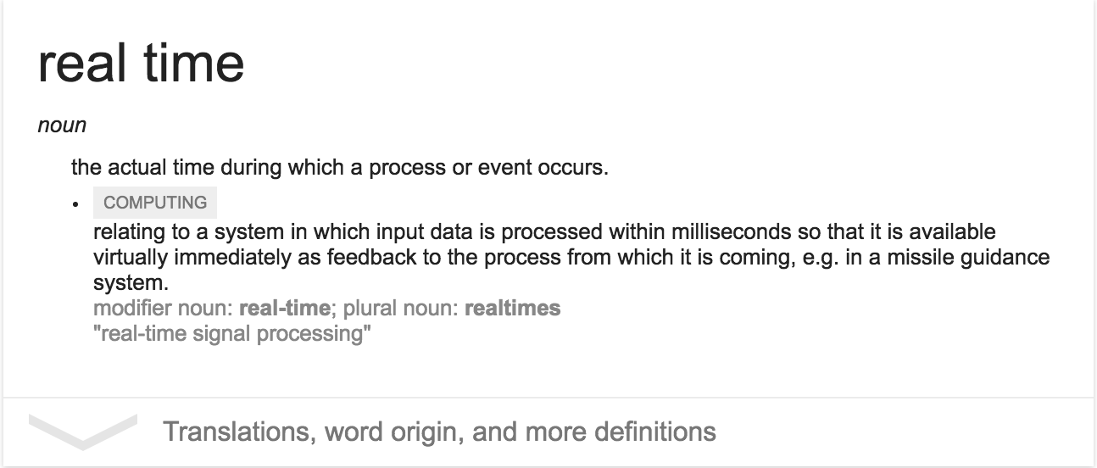
What is Real time

Slide 9
[near] real time with http
Polling
Streaming

Slide 10
Real time with Websocket
Websocket is a protocol providing full-duplex communication channels over a single TCP connection

Slide 11
what is socket.io
A JavaScript library for realtime web applications.
Enables realtime, bi-directional communication between web clients and servers.
It has two parts:
a client-side library that runs in the browser
server-side library for node.js.
Like node.js, it is event-driven.
Socket.io uses engine.io
Engine.io uses websockets
Provides the foundation of a bidirectional connection between client and server
Implementation of transport-based cross-browser/cross-device bi-directional communication layer

Slide 12
Why socket.io
Easy to use
Simplified API – warpper around websockets functionality
Low Latency
Old browsers fallback
AJAX Long polling – when websockets disabled
Scaling
Cross-browser support

Slide 13
Setup
npm install socket.io --save

Slide 14
Workflow
Configure sever to attach socket.io
01
require('socket.io').listen(server);
Configure clinet side library
02
<script src="/socket.io/socket.io.js"></script>
Establish handshake
03
Publish and Subscribe to events

